Slide 1
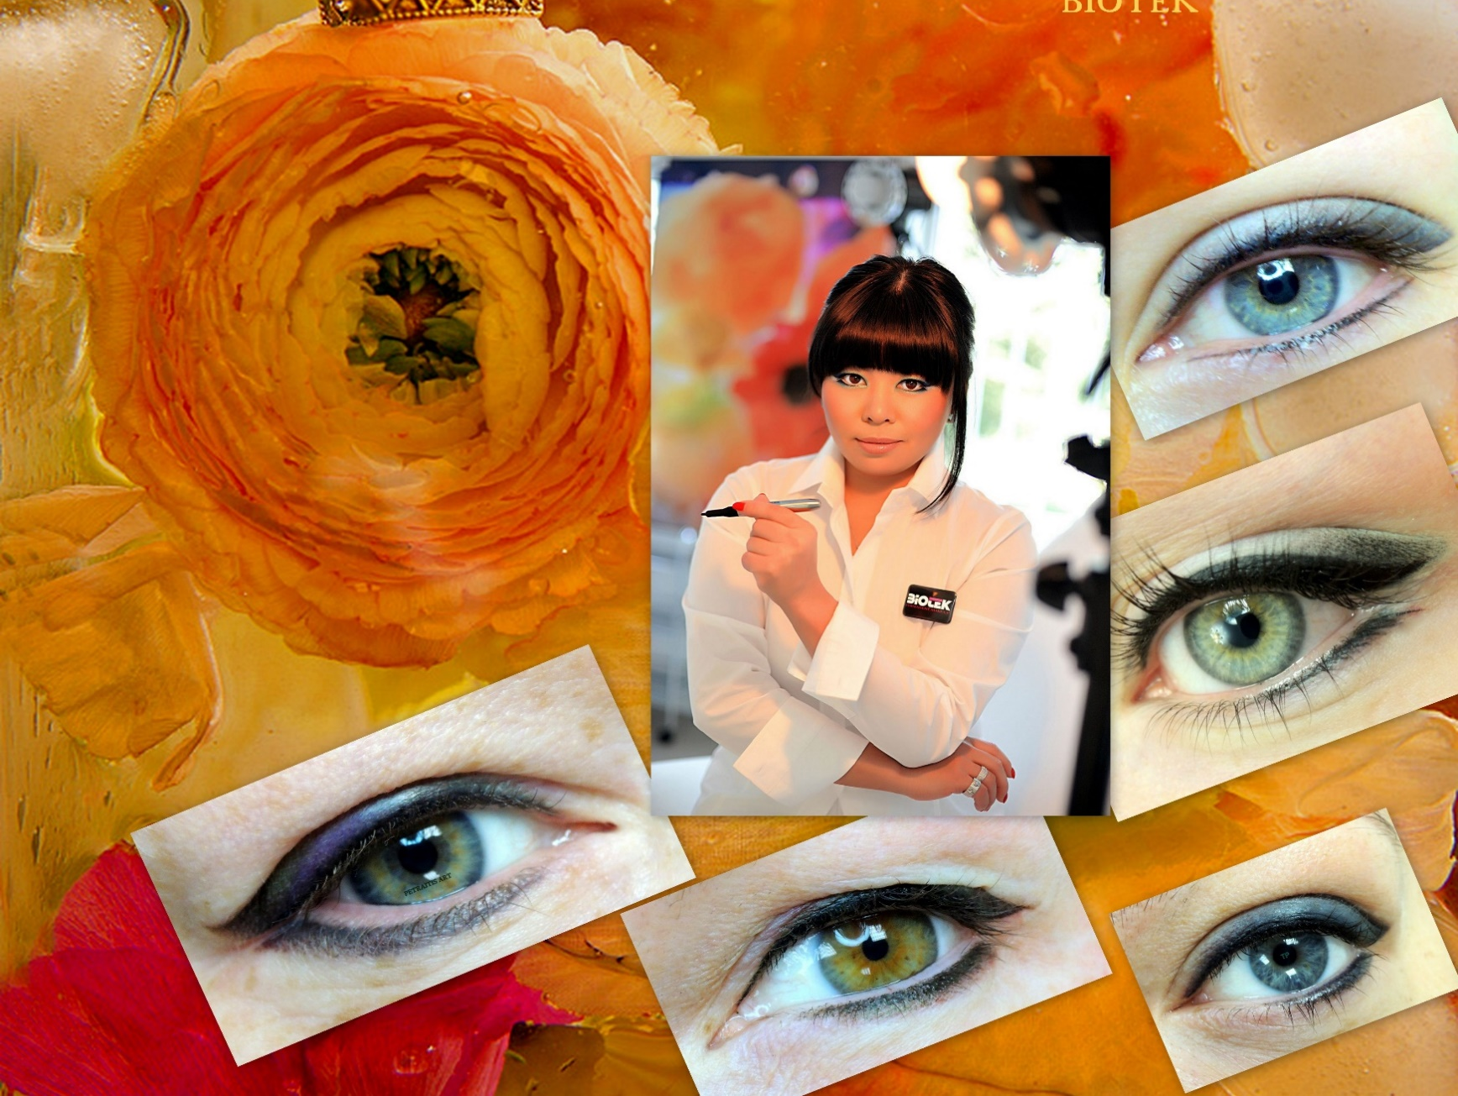

Baltic Brows PMU & microblading conference in Punta Cana, Dominican Republic, 2017

Slide 2
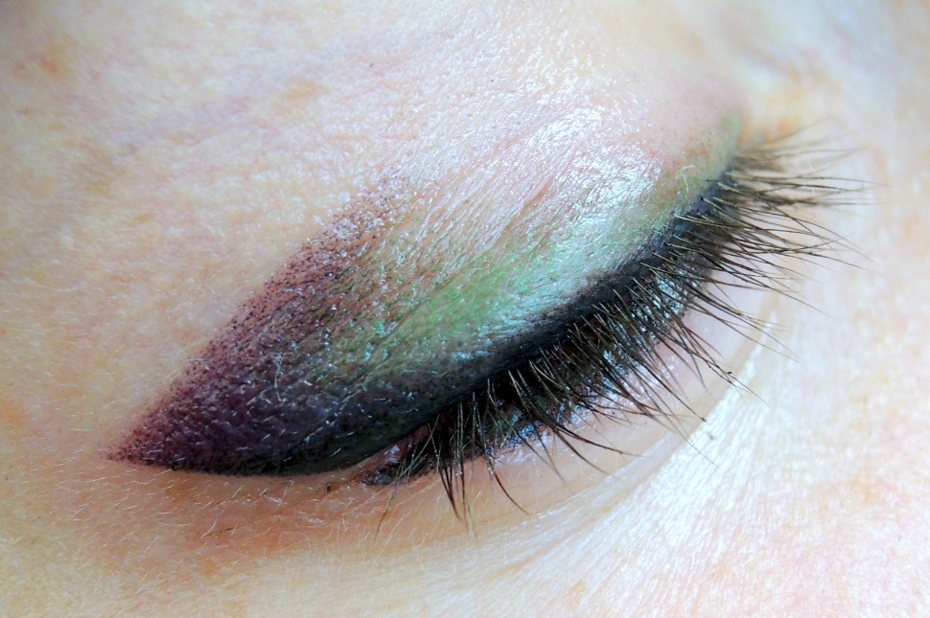
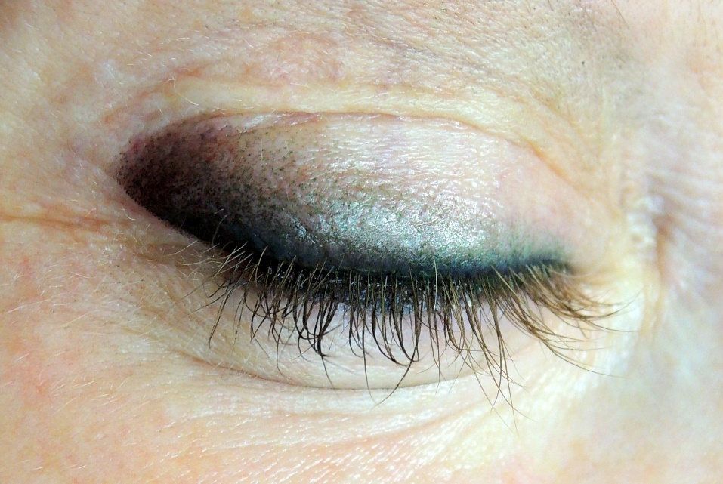
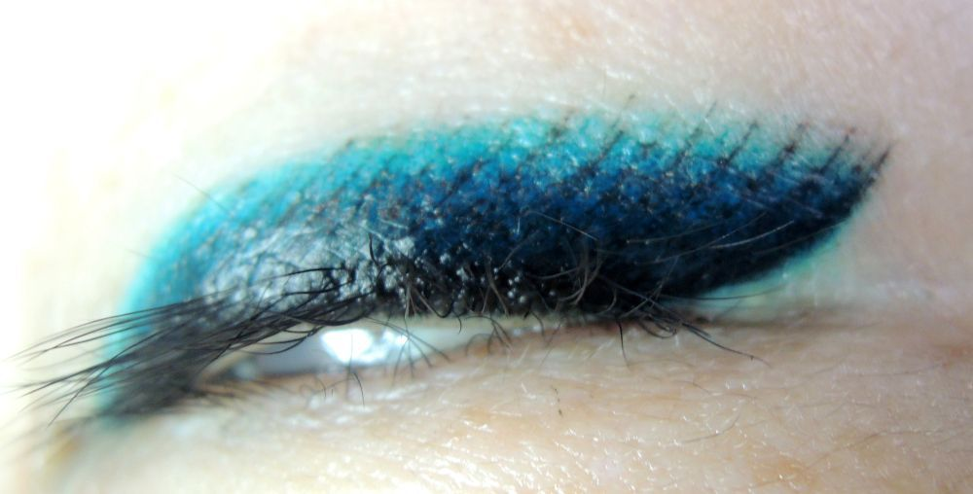
Butterfly
Smoky eyes
Baltic Brows PMU & microblading conference in Punta Cana, Dominican Republic, 2017

Slide 3
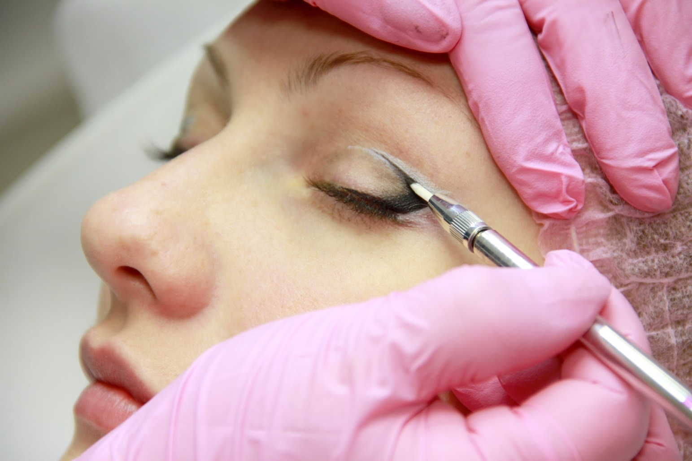
Drafting
Baltic Brows PMU & microblading conference in Punta Cana, Dominican Republic, 2017
Notes:
ОТРИСОВЫВАЕМ ИДЕАЛЬНО ЭСКИЗ ! ТЩАТЕЛЬНО И АККУРАТНО
СКИНОМ КРАНДАШОМ ФИКСИРУЕМ КРАЯ ЧТОБЫ НЕ РАСТЕКАЛСЯ ЭСКИЗ
ИНОГДА ПРИХОДИТСЯ РИСОВАТЬ ДО ПОЛНОГО ЗАВЕРШЕНИЯ .ЧТОБЫ ВИДЕТЬ КАК СМОТРИТЬСЯ В ЦЕЛОМ МАКИЯЖ В ЦВЕТНОМ ИЗОБРАЖЕНИИ

Slide 4
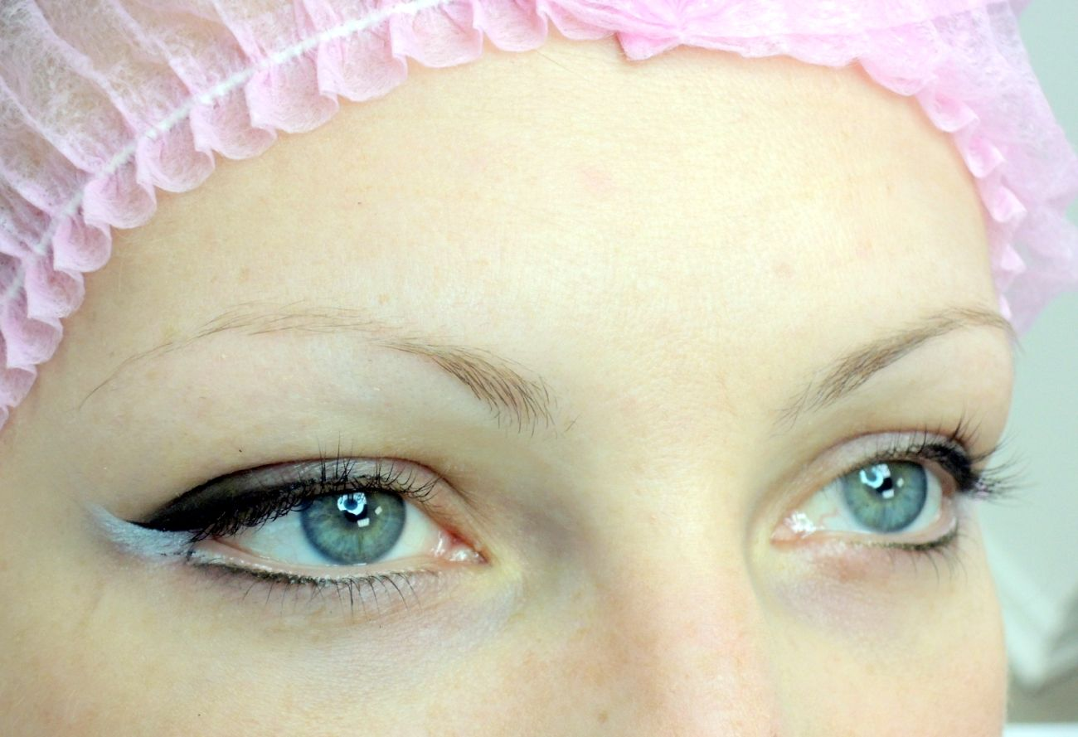
Baltic Brows PMU & microblading conference in Punta Cana, Dominican Republic, 2017

Slide 5
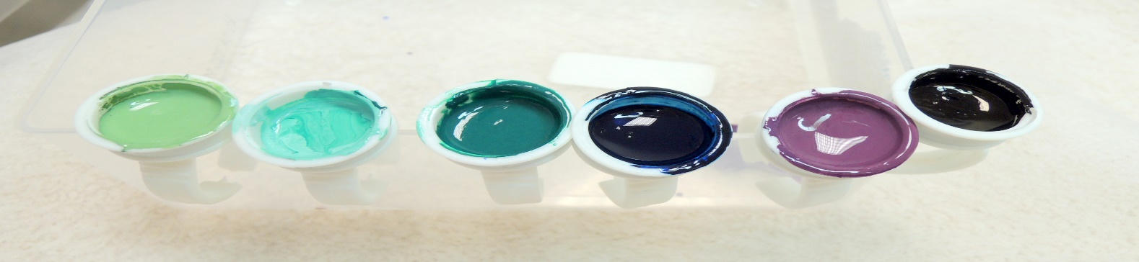
Pigments: Strong black, Black liner, Black, all brown colors from eyebrows palette, Warm grey, Brown 7, Brown 8, Brun 5, Brun 4, Cold grey, Green, Brown liner, Blue liner, Green liner, Violet liner, Green
Needles: 1 point, 1 flex, 3 soft, 3 liner, 5 point, 5 liner, 7 liner
Baltic Brows PMU & microblading conference in Punta Cana, Dominican Republic, 2017

Slide 6
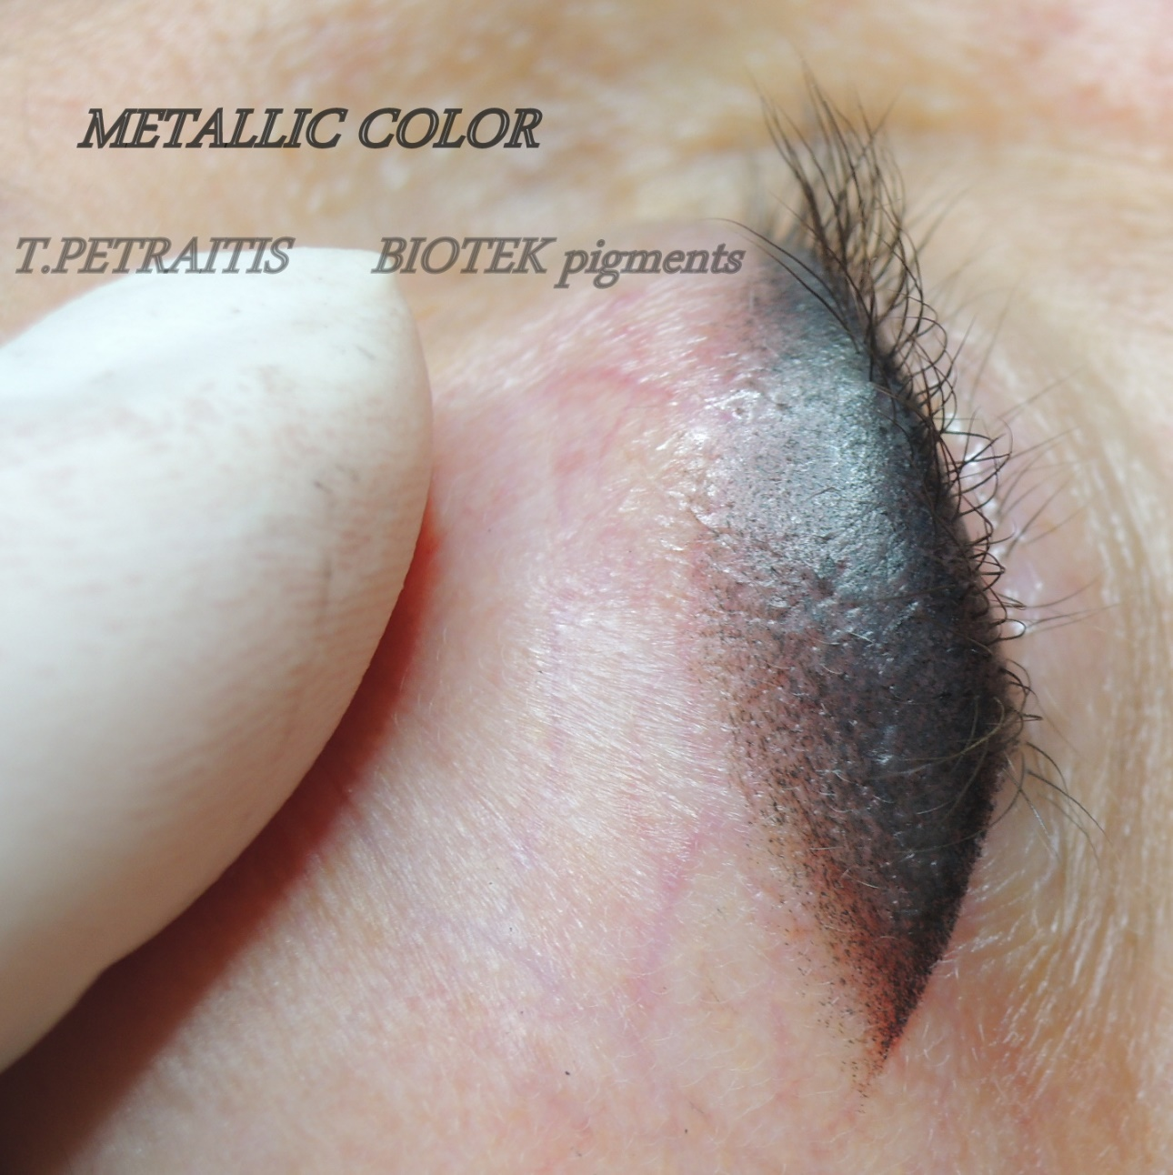
Baltic Brows PMU & microblading conference in Punta Cana, Dominican Republic, 2017

Slide 7
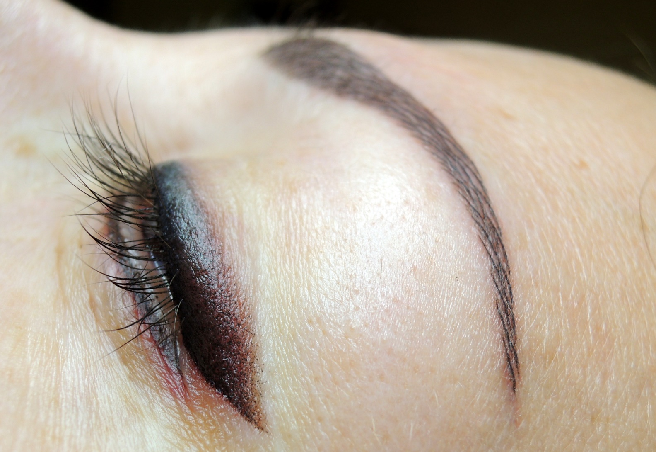
Baltic Brows PMU & microblading conference in Punta Cana, Dominican Republic, 2017

Slide 8
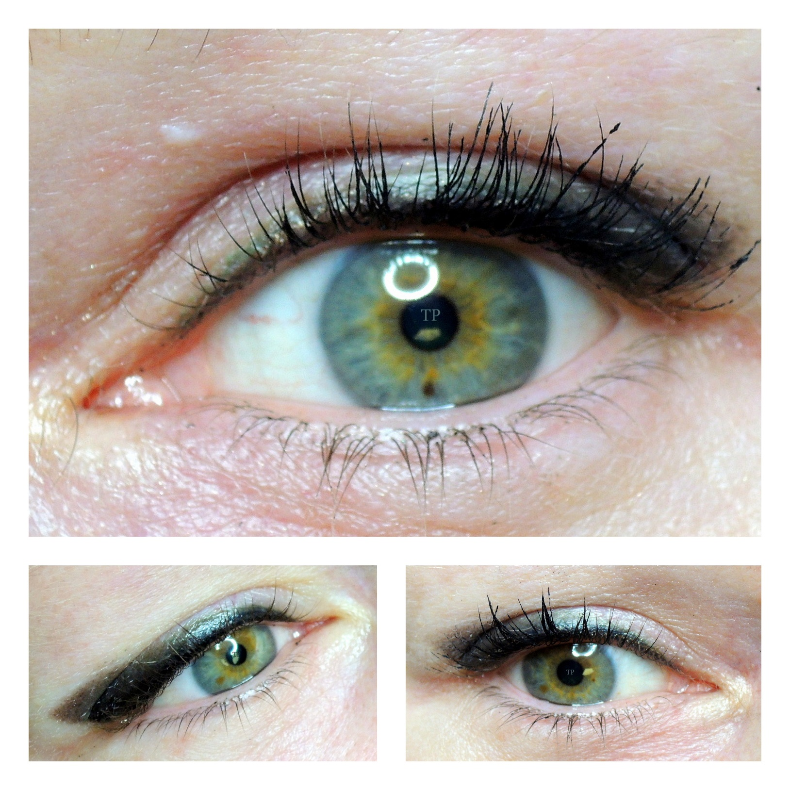
Baltic Brows PMU & microblading conference in Punta Cana, Dominican Republic, 2017

Slide 9
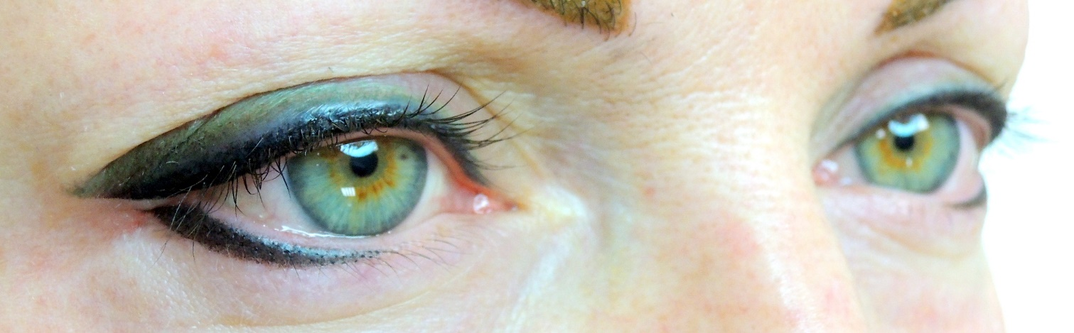
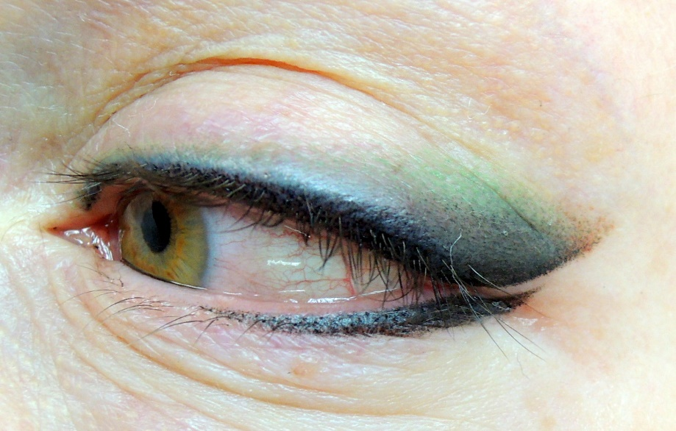
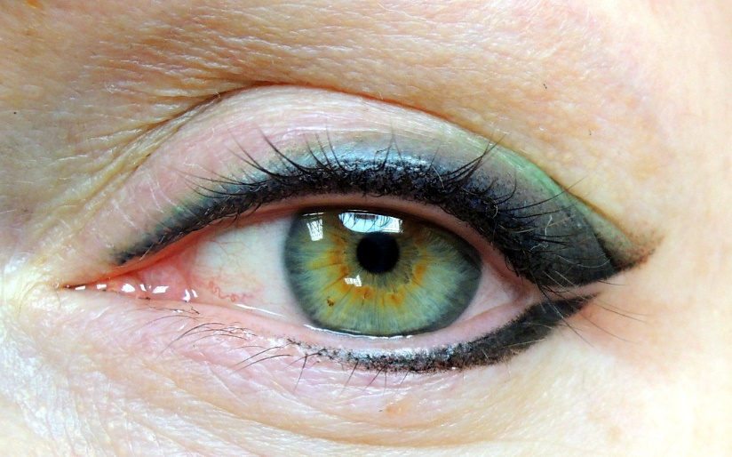
Strong black, Brun 4, Green
Baltic Brows PMU & microblading conference in Punta Cana, Dominican Republic, 2017
Notes:
VIOLET , GREEN ,
1-3-5 NEEDLES

Slide 10
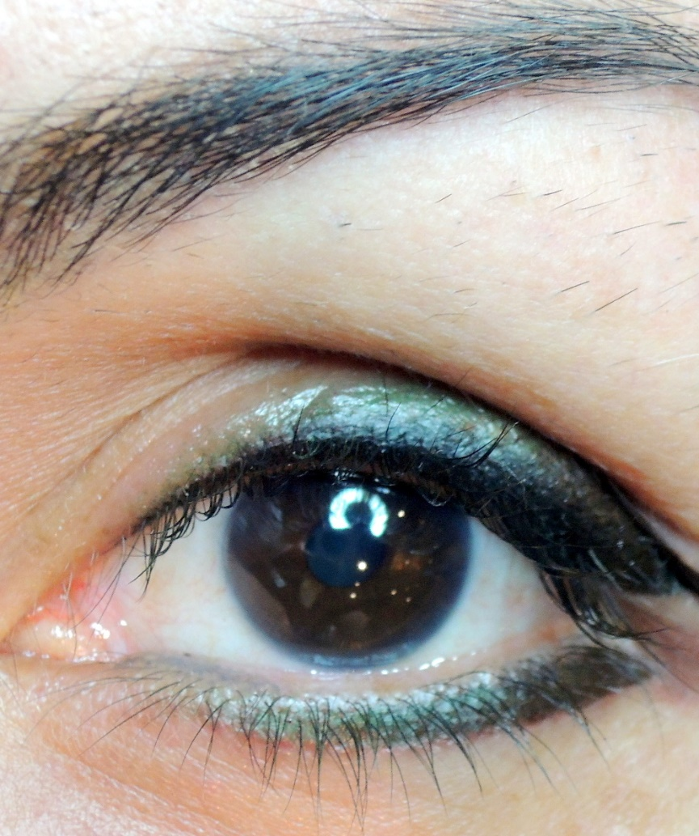
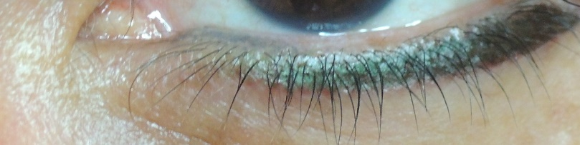
Baltic Brows PMU & microblading conference in Punta Cana, Dominican Republic, 2017

Slide 11
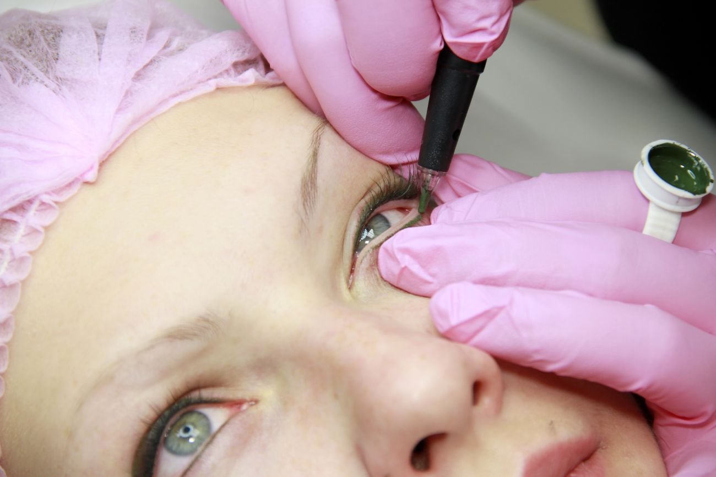
Needles for bottom of eyelid. 1-point, 3-soft, 3-liner,3-round, 5-round.
Baltic Brows PMU & microblading conference in Punta Cana, Dominican Republic, 2017
Notes:
1 МЕЖРЕСНИЧКА
3 SOFT
1 КОНТУР
И НИЖНЕЕ ВЕКО ТОЖЕ ПОТОМУ. КАК АНЕСТЕТИК ЕЩЕ ДЕРЖИТ КАКОЕ ТО ВРЕМЯ ОБЕЗБОЛИВАНИЕ
ТА ЖЕ ИГЛА

Slide 12
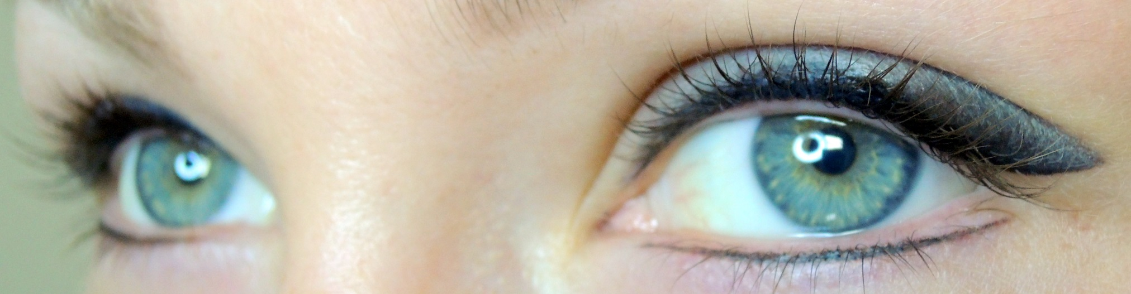
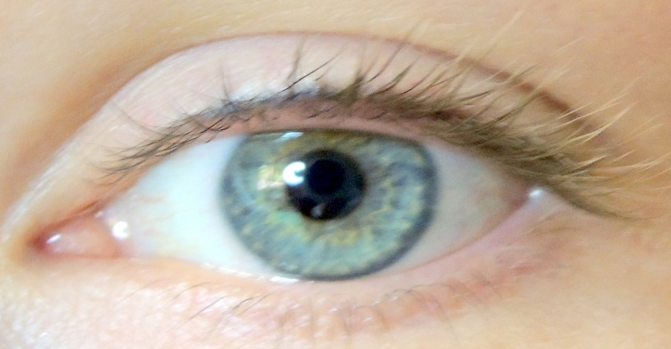
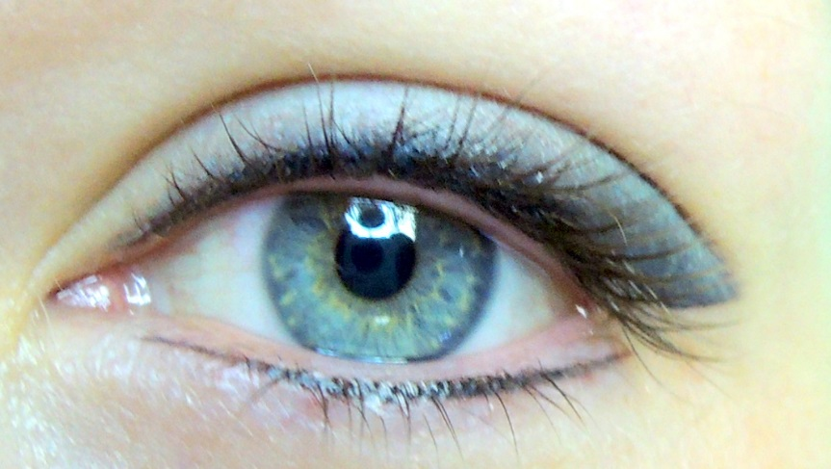
Black liner, Black, Cold grey
Baltic Brows PMU & microblading conference in Punta Cana, Dominican Republic, 2017
Notes:
STRONG BLACK, BLACK LINER ,GOLD GREY .

Slide 13
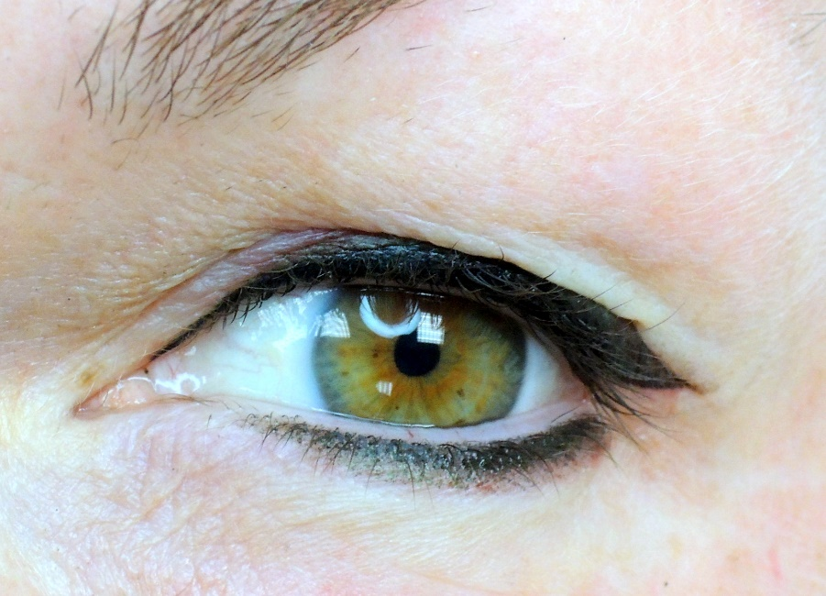
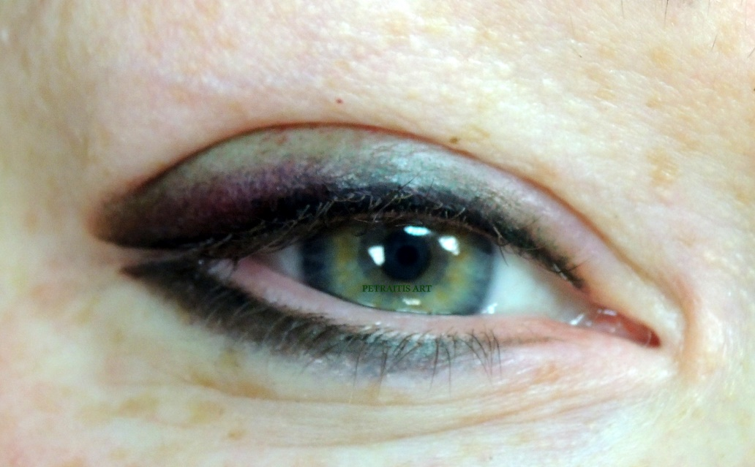
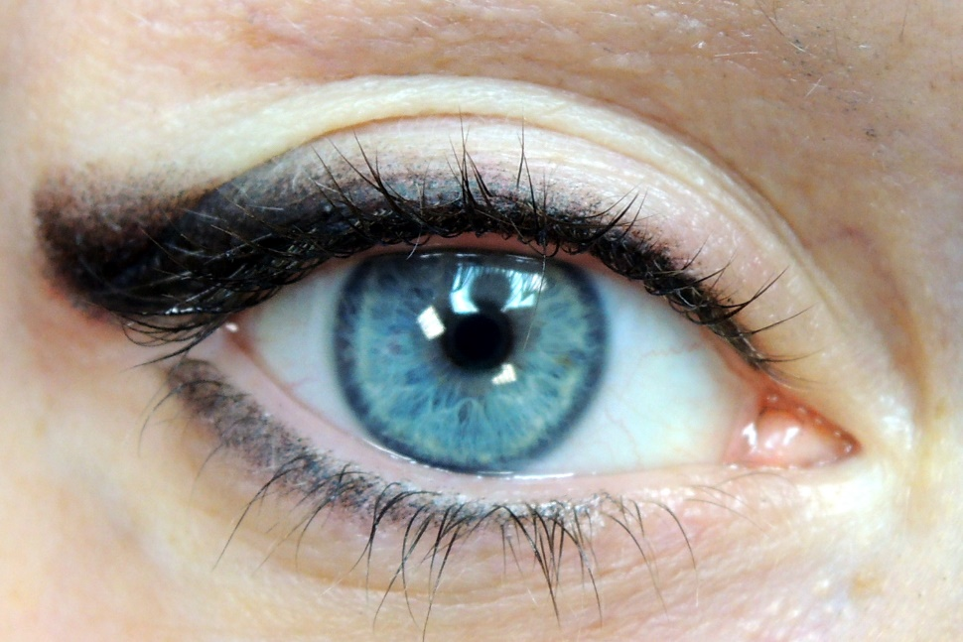
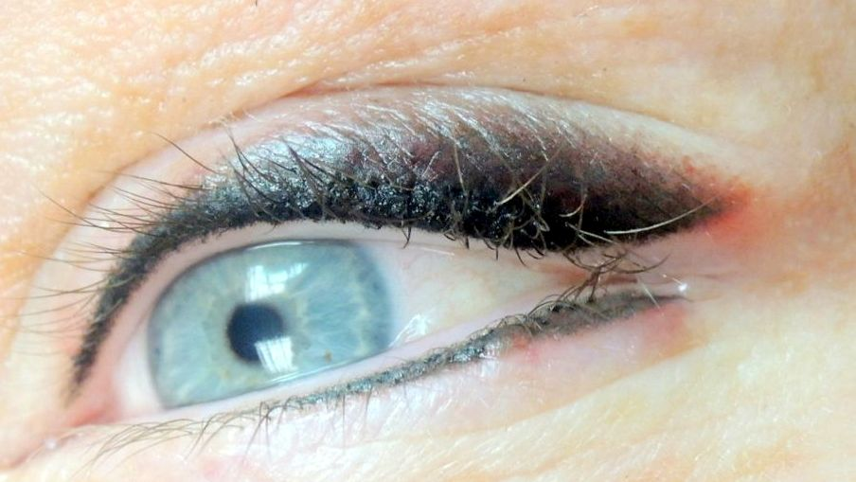
Smoky eyes
Baltic Brows PMU & microblading conference in Punta Cana, Dominican Republic, 2017

Slide 14
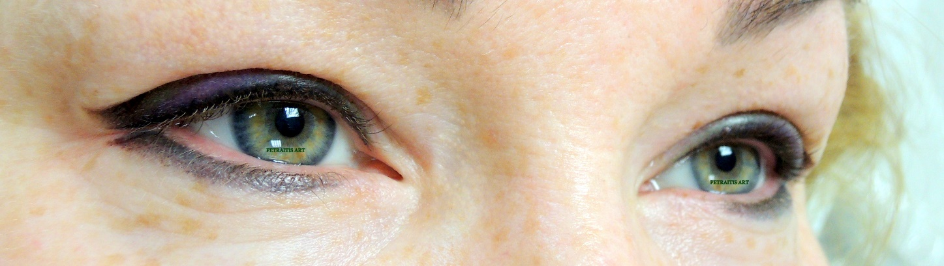
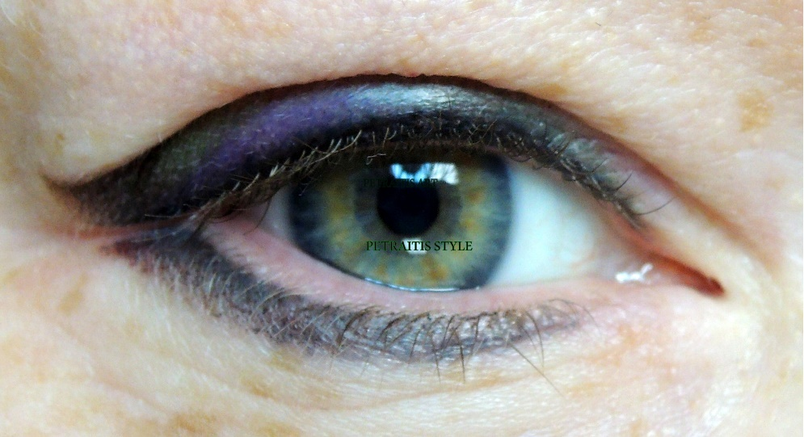
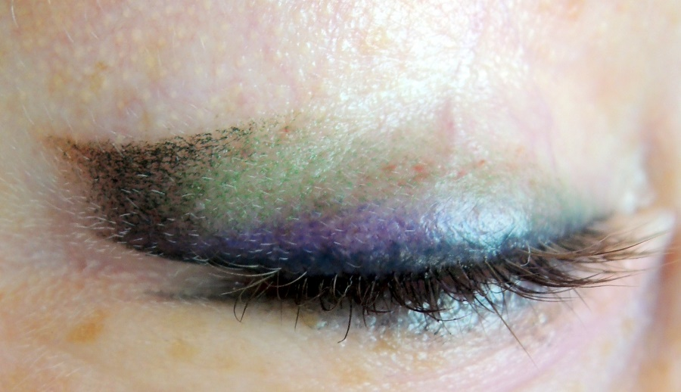
Baltic Brows PMU & microblading conference in Punta Cana, Dominican Republic, 2017

Slide 15
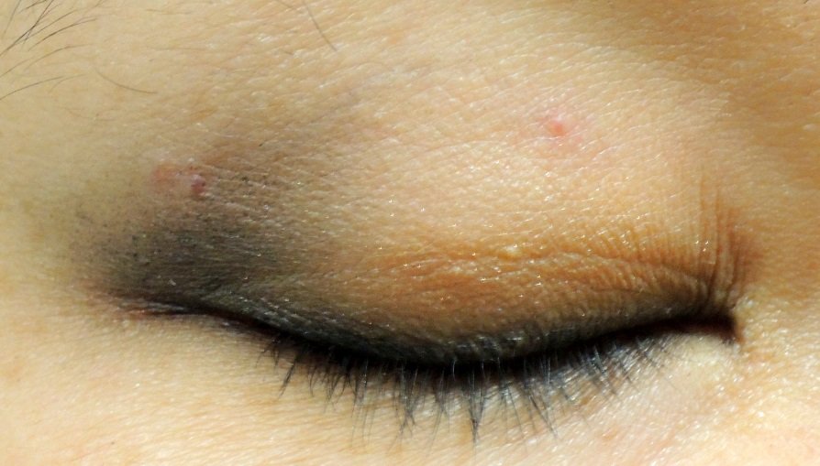
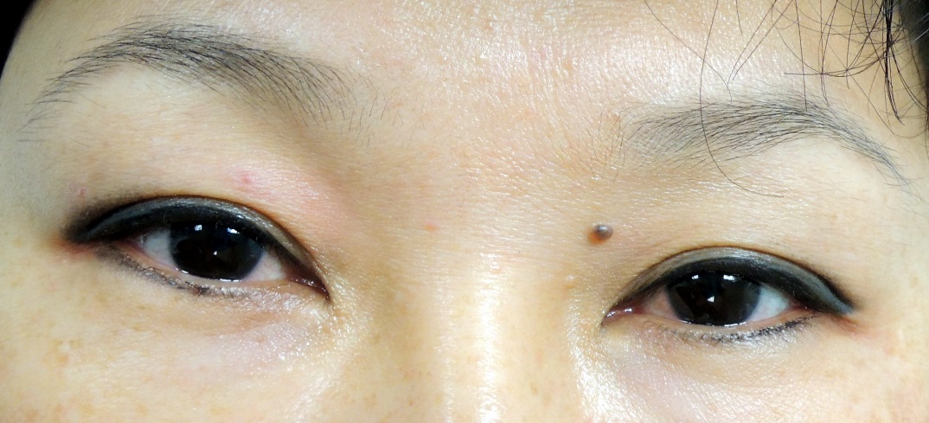
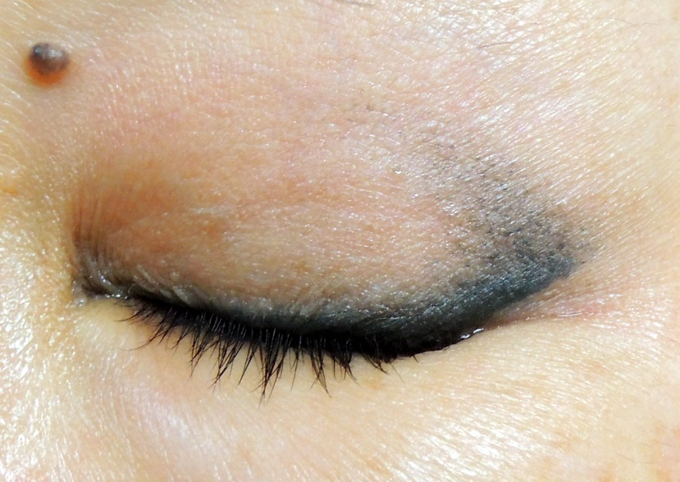
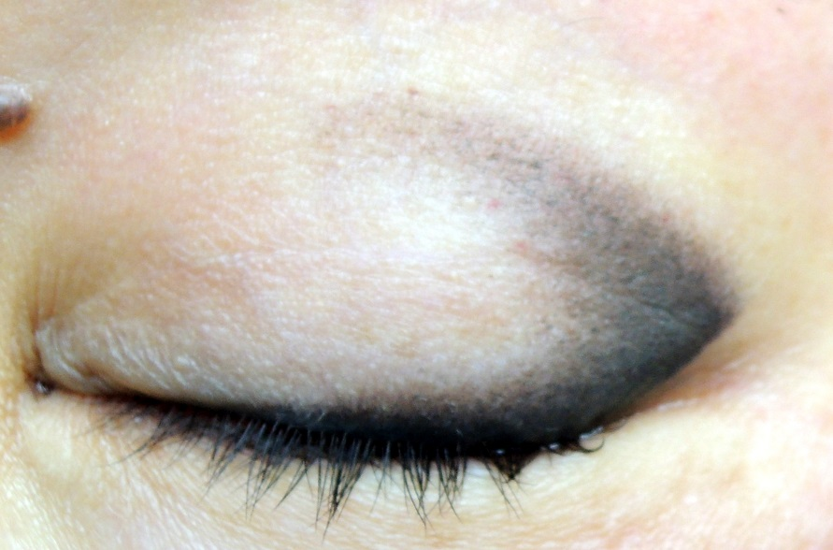
1
Asian style
2
3
4
Baltic Brows PMU & microblading conference in Punta Cana, Dominican Republic, 2017
Notes:
ИНОГДА ИСПОЛЬЗУЮ ДЛЯ ЭФФЕКТА НИЖНЕЕ ВЕКО 2 ИГЛАМИ И ЦВЕТАМИ
1 ТЕМНЫМ ПРОЙТИСЬ ЦВЕТОМ ОКОЛО РЕСНИЦ НИЖЕ 3 -5 РАСТШЕВОЧНОЙ СВЕТЛЫМ ПИГМЕНТОМ

Slide 16
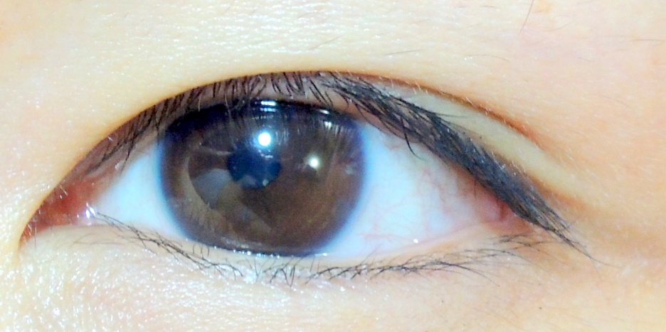
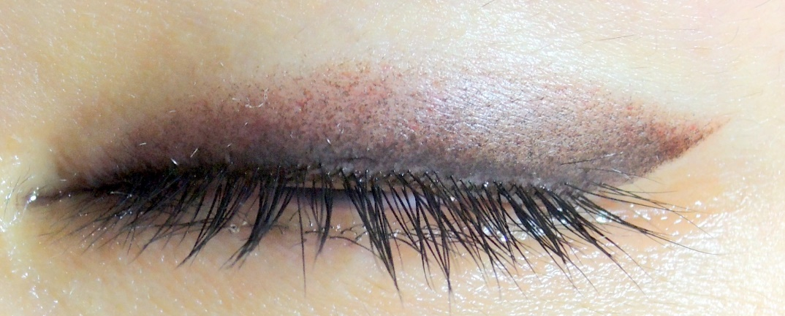
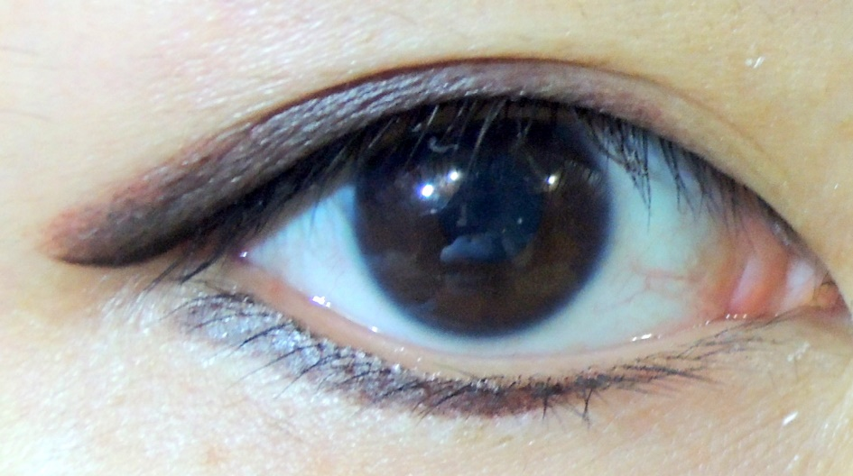
Eyeshadow
Black, Brun 4
Baltic Brows PMU & microblading conference in Punta Cana, Dominican Republic, 2017

Slide 17
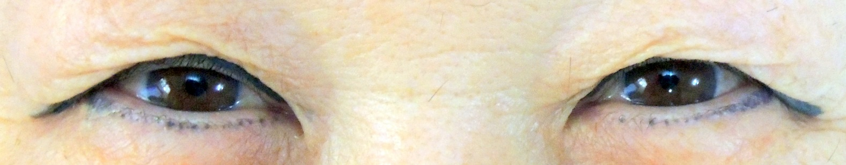
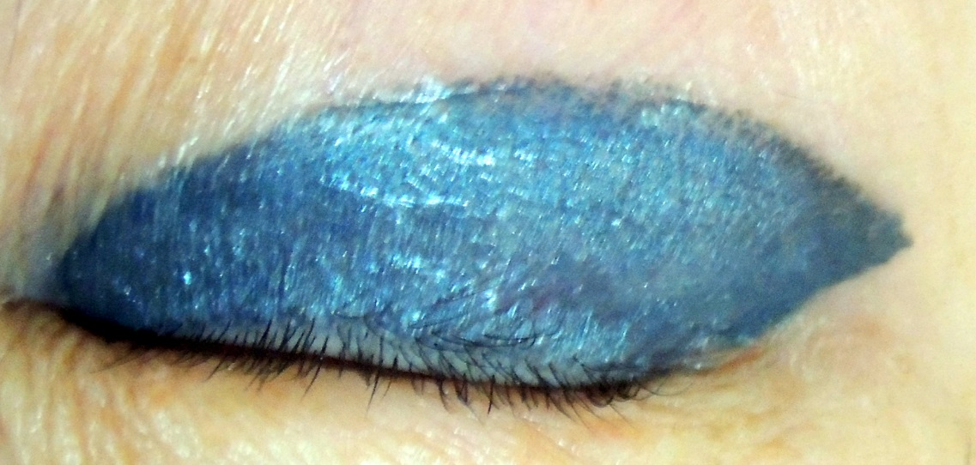
Wrong permanent make up!
Baltic Brows PMU & microblading conference in Punta Cana, Dominican Republic, 2017

Slide 18
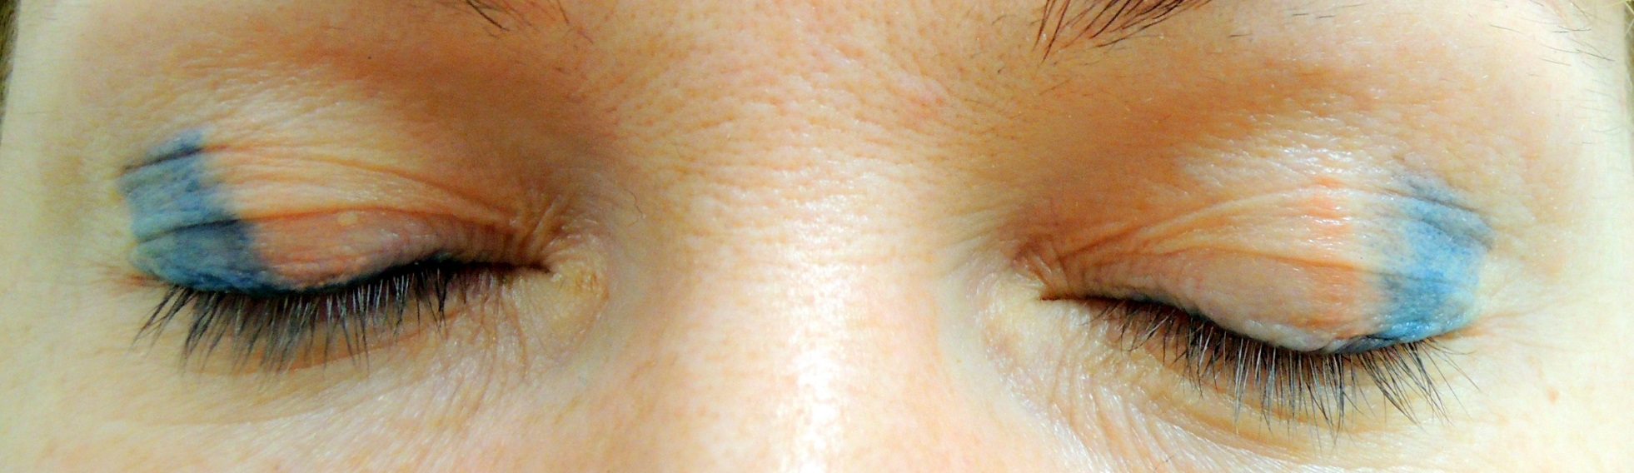
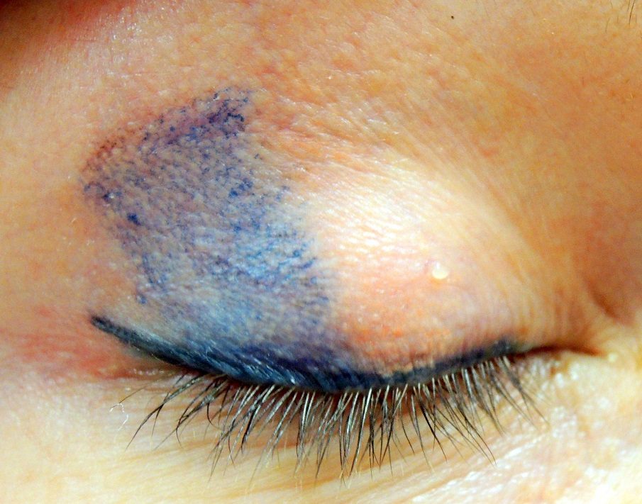
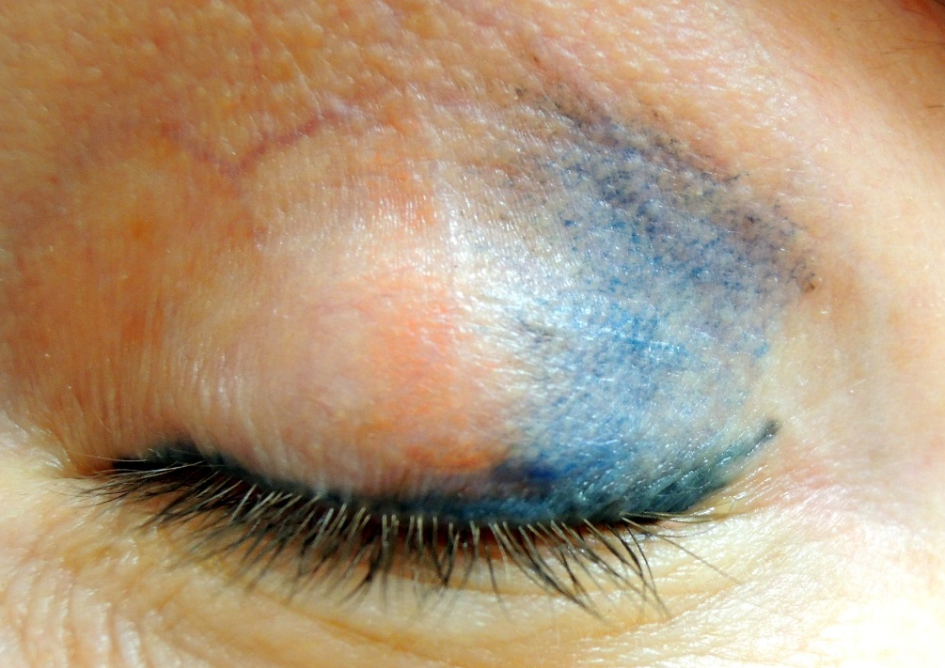
Baltic Brows PMU & microblading conference in Punta Cana, Dominican Republic, 2017

Slide 19
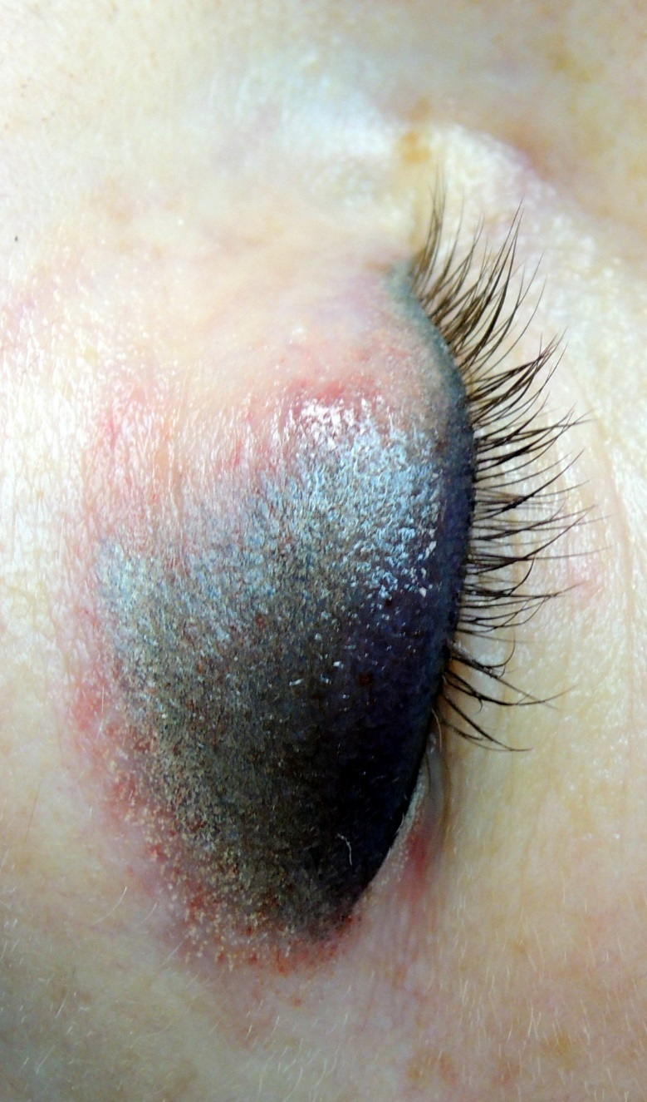
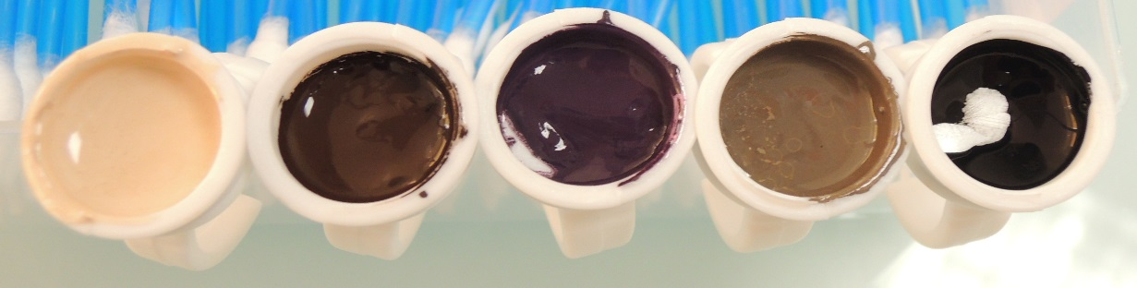
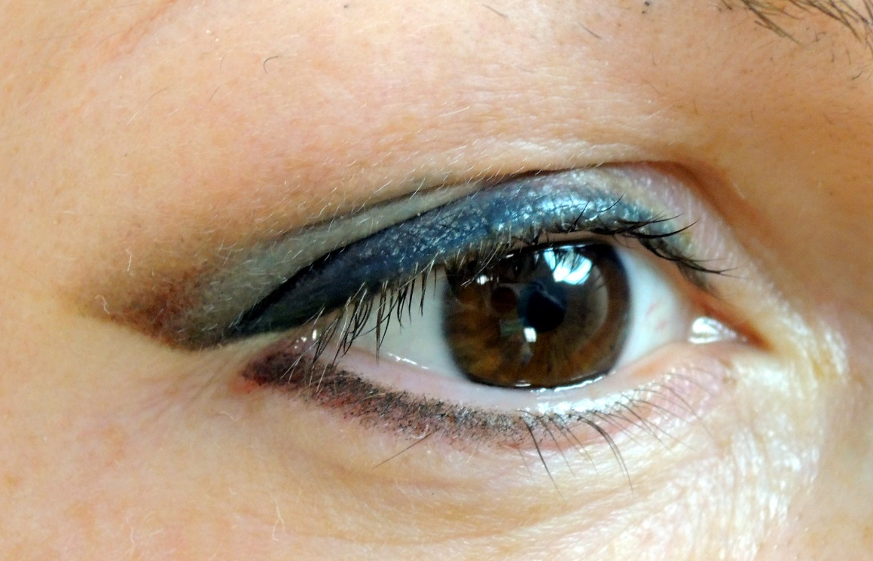
Covering - up
Baltic Brows PMU & microblading conference in Punta Cana, Dominican Republic, 2017

Slide 20
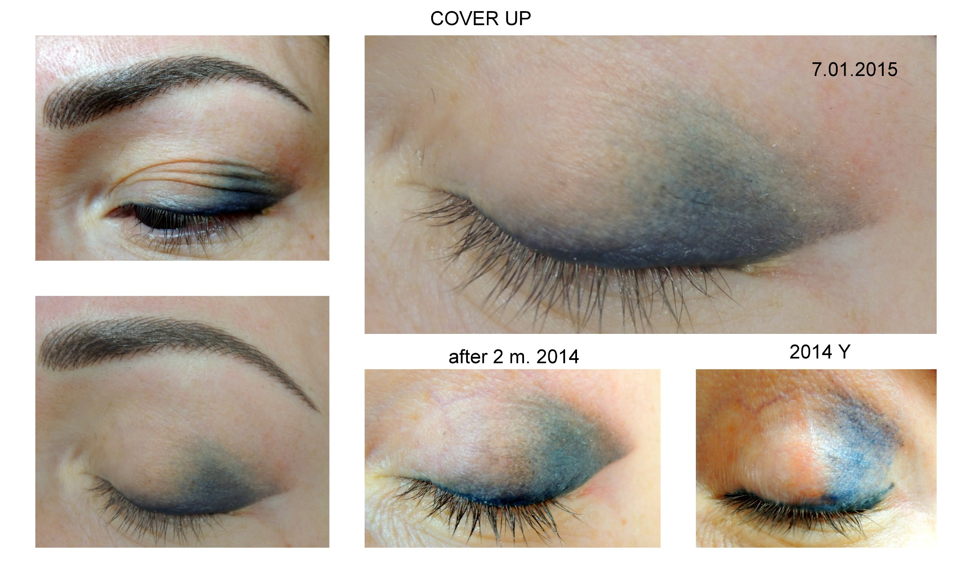
Baltic Brows PMU & microblading conference in Punta Cana, Dominican Republic, 2017

Slide 21

Thank you for attention!
Art-Academy Permanent Make-Up
www.petraitis-art.com
Baltic Brows PMU & microblading conference in Punta Cana, Dominican Republic, 2017

